Slide 1
1 meter of elevation head
1 meter
Reference elevation
1 meter of pressure head
1 meter of velocity head

Slide 2
V_{in}
V_{out}
A_{in}
x
A_{out}
in
out

Slide 3
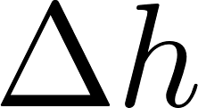
Horizontal orifice
Vertical orifice

Slide 4


A
B

Slide 5
Pipe stub
Pipe coupling

Slide 6



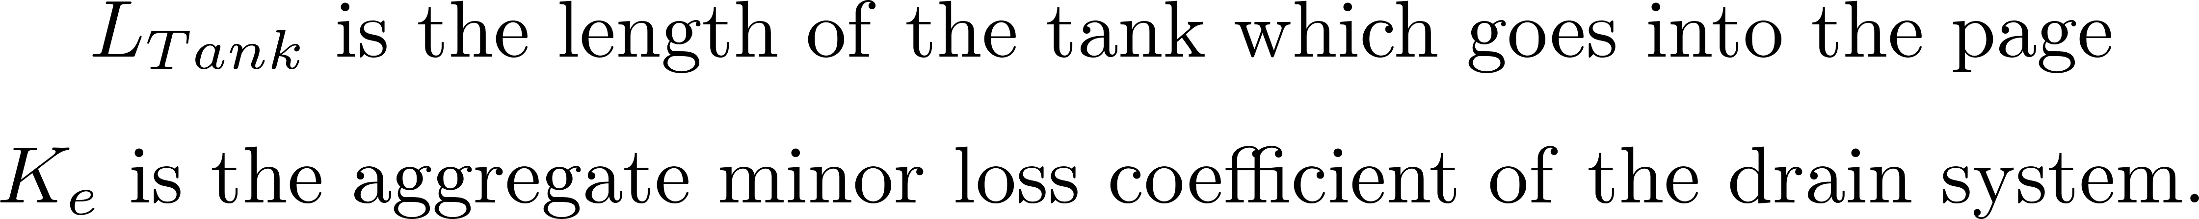

Slide 7
C
B
A

Slide 8


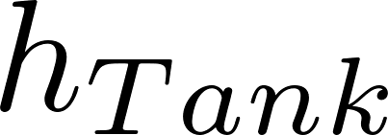
Tank
Valve
Water source pipe
Tank
Valve
Water source pipe

